Slide 1
Capstone Project
EDA Hotel Bookings Analysis Avinash Gangarde Almabetter cohort Azaadi

Slide 2
Overview :
1) Introduction.
2) General overview of dataset.
3) Missing value Handling.
4) Univariate Analysis.
5) Bivariate Analysis.
6) Conclusion.

Slide 3
Introduction.
Hotels are one of the major part of service industry.
Data is Given about hotels and their related things .
Data analysis on this hotels can help them to know about what are the things that are performing good and things that are performing bad .
Insights derived from this dataset can help them to understand better about them.
Data generated from different channels can helps this industry to deliver better service , they can improve their customer service , and also they can use it to run different marketing campaigns .

Slide 4
General overview of dataset.
This dataset is giving information about City hotels and Resort hotels.
This dataset includes both strings , float and object type of data .
Total 32 columns are present in the dataset.
Total rows are 119390.
Data set has three columns that has null values namely company , agent and
country .
Data set includes information of three year are 2015,2016 and 2017.
Dataset include information about adults , children , babies, countries ,meal , agents , bookings ,and arrival by months and dates etc.

Slide 5
Dealing with NaN values.
‘children’ = 4 NaN values.
‘country’= 488 NaN values.
‘Agents’= ‘16340’ NaN values.
‘company’=‘112593’ NaN values.
children columns has minimum value of 0 so I decided to replace it 0
Country columns has different country names so there are some places where the country name is not filled so in I decided to replace it with Anonymous.
Agents columns has minimum no of agents are 0 so its better replace it with zero
In company columns there are lot of Nan values almost near to the observations I decided to drop that columns .

Slide 6
Univariate Analysis.

Slide 7
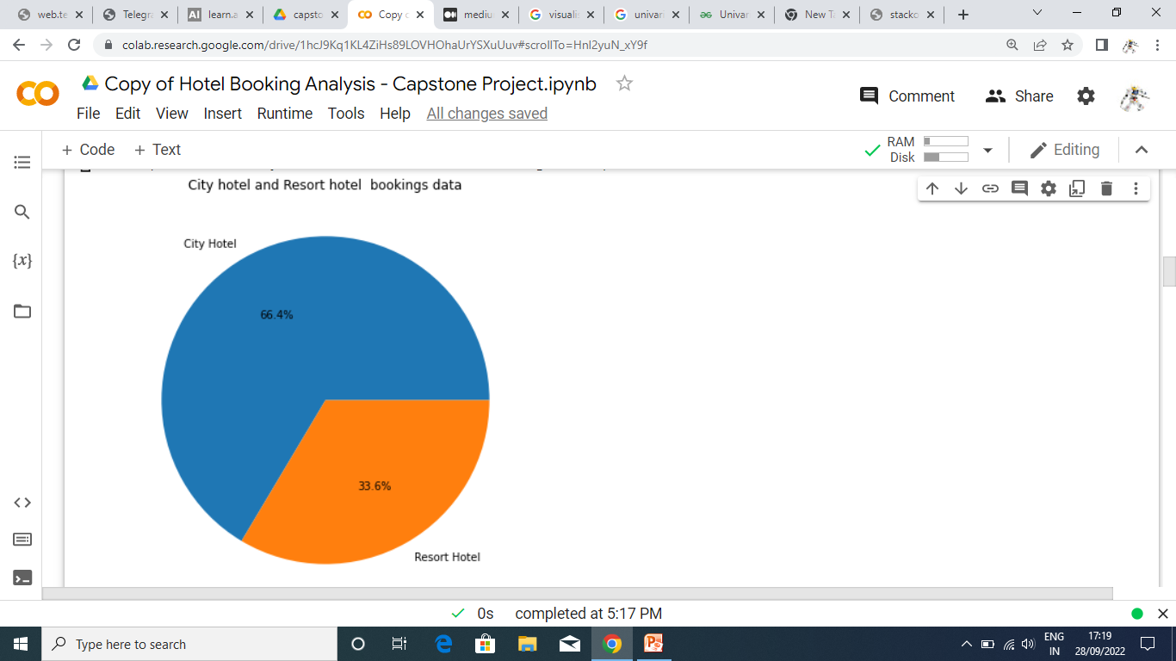
City hotels and Resort hotel booking comparison

Slide 8
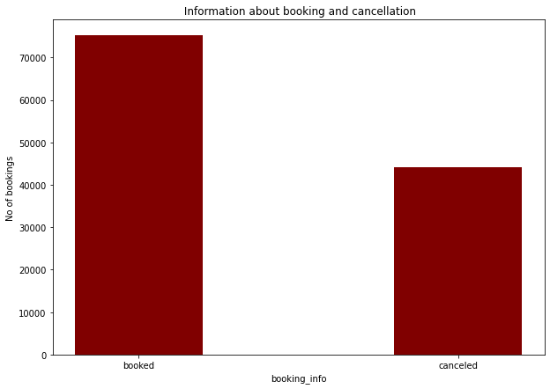
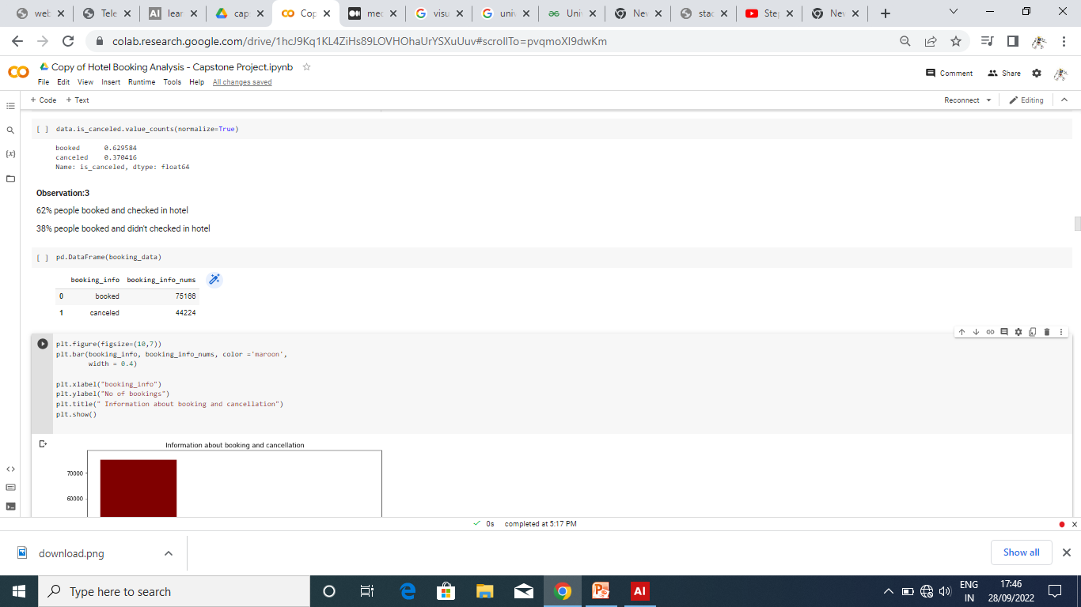
Booking and cancelation data analysis

Slide 9
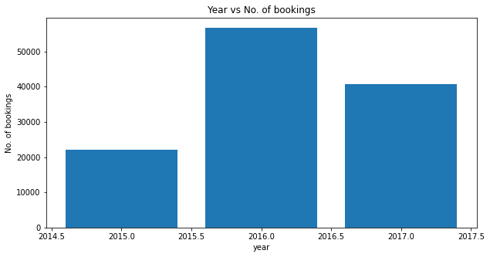
Year vs number of bookings

Slide 10
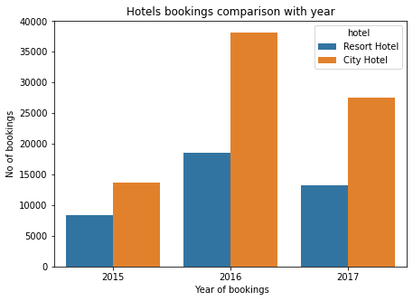
Hotels and their respective bookings in year

Slide 11
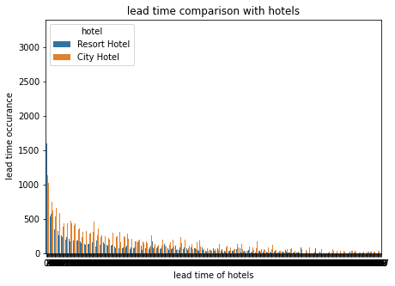
Lead time comparison with hotels

Slide 12
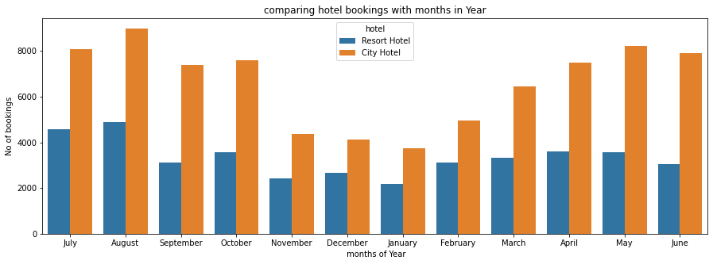
Comparing the months against the bookings

Slide 13
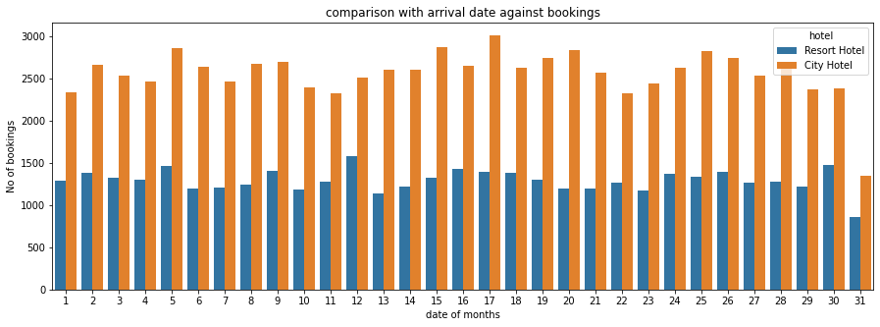
Comparing the arrival date against no of bookings

Slide 14
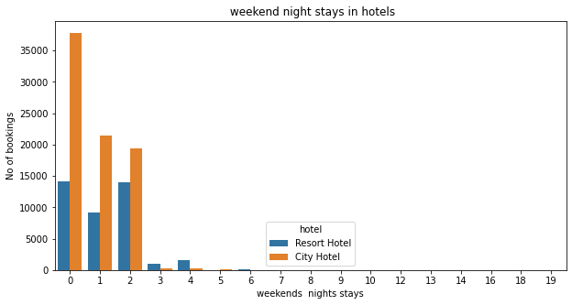
Comparing weekend nights stays in hotels

Slide 15
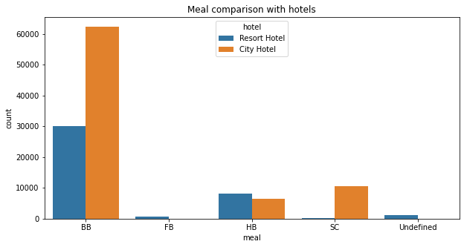
Meal comparison among hotels

Slide 16
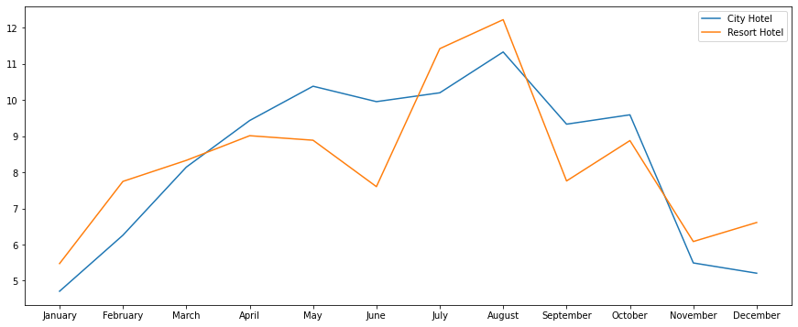
No of bookings comparison with months

Slide 17
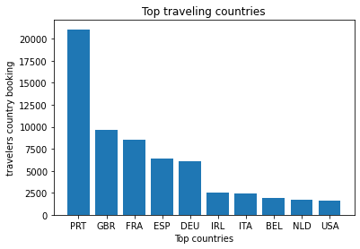
Countries and their No of bookings
country | bookings
PRT | 21071
GBR | 9676
FRA | 8481
ESP | 6391
DEU | 6069

Slide 18
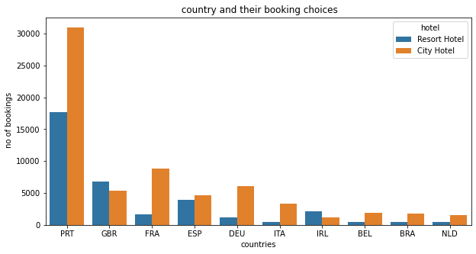
Countries and their booking choices

Slide 19
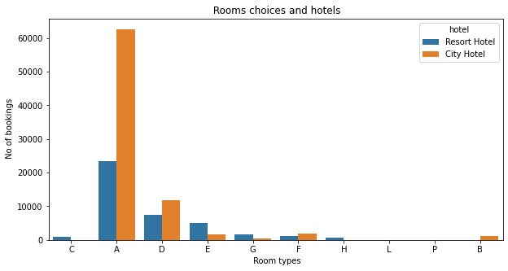
Room choices of customer according to Hotels

Slide 20
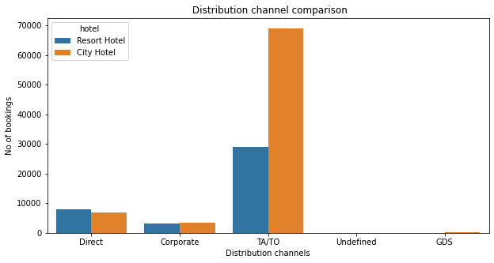
Performance of Distribution channel comparison with hotels

Slide 21
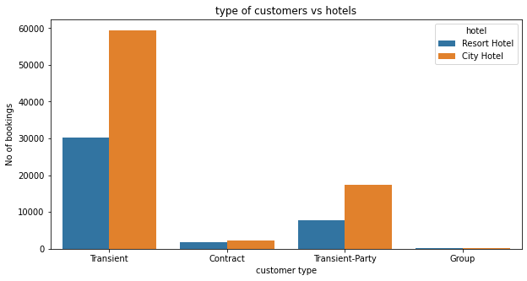
Customer type vs Hotels comparison

Slide 22
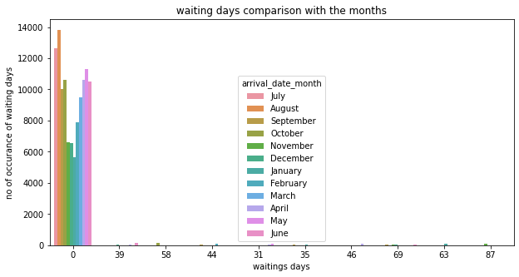
Waiting days comparison with the months

Slide 23
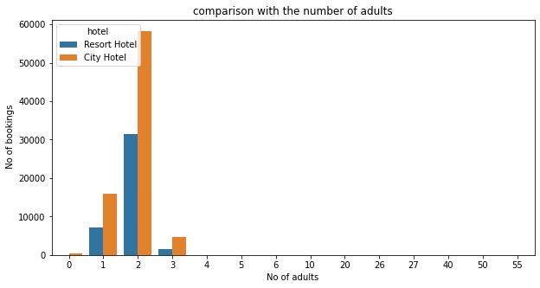
Type of customer bookings vs Hotels

Slide 24
Conclusion:
66.4 % hotels are City hotels and 33.6 % are Resort Hotels.
62% is booking rate and 38% are cancelation rate
city hotels have more cancelation rate and vice versa.
Lead time is more in city hotels than the Resort hotels.
August is busiest month and December is least busiest months.
BB ( bed and breakfast) mostly prefered meal type in city and Resort hotels.
Portugal, Great Britain ,France are top three countries with most number of bookings.
TA/TO is top performing distribution channel amongst rest of all.
Both hotels have mostly transient type of customers.
Chances of getting same assigned room is more in Resort hotel than city hotel.
Bookings are mostly done by couples followed by singles and family and friends.

Slide 25
Thank you !

